Slide 1
TERM PAPER ECO311A
Base Research Paper Religion and Economic Development - A study on Religious variables influencing GDP growth over countries (By Wonsub Eum, University of California)
Team Members :
Aditya Kumar Mishra (200049) Jayesh Shyamlal Baretiya (200476) Satmeet Singh Saluja (200890)

Slide 2
Introduction
The paper explores the relationship between religion and economic development, particularly in terms of how religious variables influence GDP growth across countries.
It notes that religion has been a significant cultural and social institution throughout human history, and has played an important role in shaping human behavior, values, and beliefs.
The paper begins by reviewing the existing literature on the relationship between religion and economic development, and note that while there is no clear consensus on the issue, there are various theories and empirical studies that suggest a link between religion and economic outcomes.
It then discusses the theoretical framework and methodology used in the study, which involves using a panel dataset of 142 countries over the period of 1985-2010, and regressing GDP growth rates on a set of religious variables, along with various control variables.

Slide 3
Introduction
The religious variables used in the study include the proportion of the population that is Muslim, the proportion that is Christian, the proportion that practices traditional religions, and the proportion that is unaffiliated.
The paper presents the empirical results of the regression analysis, and finds that there is a statistically significant positive relationship between the proportion of the population that is Christian and GDP growth rates, but no significant relationship between the other religious variables and GDP growth rates.
The paper concludes by discussing the implications of the findings for economic development policy, and suggests that policymakers should take into account the potential positive effects of religious diversity and religious institutions on economic growth, while also being mindful of the potential negative effects of religious conflict and intolerance.

Slide 4
Why this paper?
•“Tirumala Tirupati Devasthanams, arguably one of India’s richest temples, has approved ₹4,411.68 crore as its annual budget for 2023-24. The TTD Trust Board, which met at Tirumala on Ugadi (Telugu New Year’s Day) on Wednesday, approved the budget, which is said to be the highest ever since the inception of the temple body in 1933”. (Taken from : “https://www.fortuneindia.com/enterprise/tirumala-tirupati-temple-budget-biggest-in-90-years-hundi-collection-up-33-since-covid/112000”)
•We were surfing the Internet the different revenue sources of the State Government and found out that in Karnataka, in the year 2019, almost 79 crore rupees were collected from over 2 lakh temples. Then we just thought of the amount collected by Tirupati Temple and found out a whooping 4411.68 crores!

Slide 5
Why this paper?
So we turned to ChatGPT and asked it to tell us the papers which have been researched on the topics of Religion and Economic Growth, it listed a lot of them, but none of them was based in India, which was our priority.
We then read the abstracts, methodology, and results of around 12-14 papers provided to us by ChatGPT; we compared based on the dataset(spiritual and economic growth, both), the methodology(normal regression would not work as there is a factor of human sociology involved), and how well the results are explained.
We found the paper we are using the best available option, as it has used two models, one based on FRAG and POL, the other based on Church Attendance and belief in Hell or Heaven. These models were quite fascinating to us, and the logic behind them is nicely explained in the model. •

Slide 6

Methodology
Model with fragmentation and polarization : Two religious variables that will be added to the Solow model. a] Index of religious fragmentation (FRAG) : interpreted as the probability that two randomly selected individuals in a country will belong to different religious groups.
N_{ij} / N_{i} is the proportion of people affiliated to religion j in country i .
FRAG increases when the number of groups increases, especially with diverse religions without a major religion.

Slide 7

Methodology
Model with fragmentation and polarization : b] Equation of religious polarization (POL) :
where π ij is n_{ij} / N_{i}
On the opposite side of the fragmentation index, polarization index reaches a maximum of 1 when there are two religious groups of equal size, indicating that the two largest religious groups are having influence on the same number of people in the society (Montalvo and Reynal-Querol, 2002).

Slide 8
Methodology
Model with fragmentation and polarization :
This paper adopts the augmented Solow model proposed by Mankiw, Romer and Weil (MRW) in 1992.
Incorporating previous variables mentioned into the augmented Solow model, our final equation will be as following :
where the additional variables FRAG and POL will have dummy variables, in order to observe how each variable together or by itself affect the growth rate.
where S_{k} is the rate of investment in physical capital, s_{h} is the rate of investment in human capital, n is the growth rate of population, g is the rate of technological change, δ is the depreciation rate.

Slide 9
Methodology
Model with monthly church attendance and belief in hell or heaven: Three religious variables that will be added to the Solow model. a] Monthly church attendance : More frequent church attendance implies spending more time on religious activities, and thus might lower the productivity. On the other hand, religious activities may inspire volition and refresh, and also encourage punctuality in some religions b] Belief in hell and Belief in heaven : These two indicate the fraction of people who distinguished themselves as believers in hell or heaven, from fourth-wave of World Values Survey (2009), it is a yes/no survey.

Slide 10
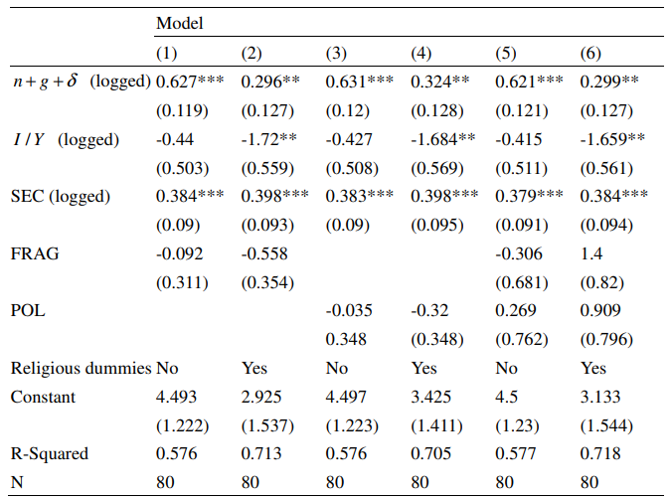
Results
Estimation of Augmented Solow Model with religious fragmentation and polarization, with religious dummies :
When regressed only with FRAG or POL, they were both negatively but not significantly related with GDP growth
However when we regress both variables with dummy, they are rather positively related with growth, again not significantly.

Slide 11
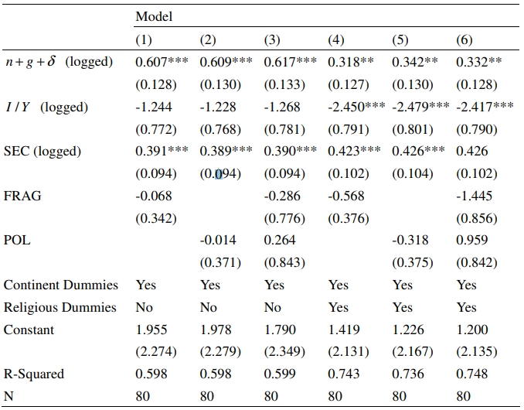
Results
Estimation of Augmented Solow Model with religious fragmentation and polarization, with continent dummies:
With continent dummy added, we reach to the same conclusion that religious fragmentation and polarization do not seem to have a strong correlation with economic growth.
Although not significant, POL had both positive and negative relation with GDP growth, showing that it cannot be concluded that POL necessarily impacts the economic growth negatively

Slide 12
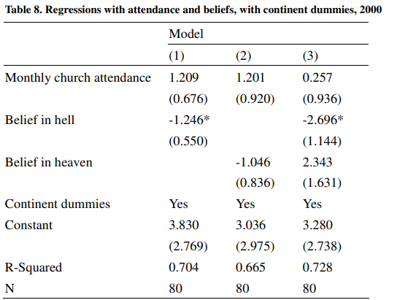
Results
Regressions with attendance and beliefs, with continent dummies, 2000:
Influence from monthly church attendance and belief in heaven are not significant.
Belief in hell had a strong negative relation with growth, even with elimination of geographic difference
*Other explanatory variables were included but coefficients are not shown

Slide 13
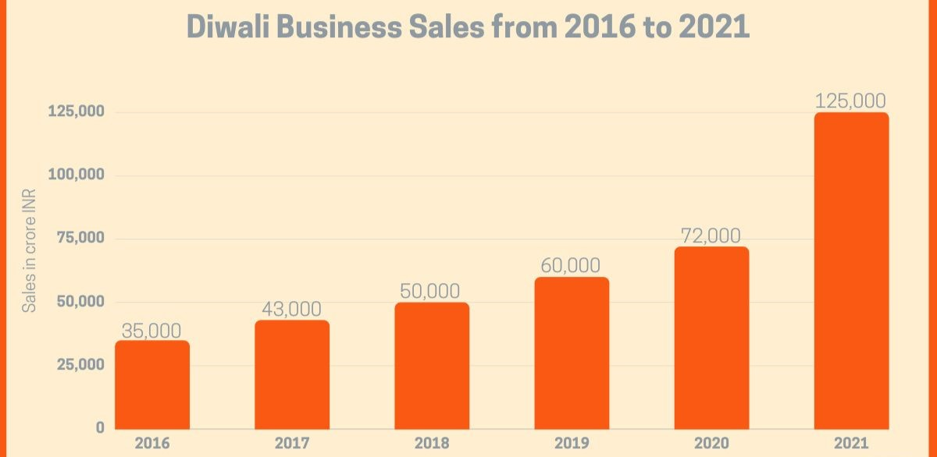
Role of religion in society and economy
The concept of the paper is hugely appealing to a country like India, where the population believing in any religion forms a huge majority.
Other than the obvious economic boosts provided by annual religious festivals, religious impact on work ethic and social capital is supported by previous research.
The impact of Diwali in creating trade on an annual basis.

Slide 14
Learnings from the paper
FRAG & POL : These are the mathematical models which helped us understand the integration of societal factors such as religion into empirical research.
Church Attendance : We learnt the effects of religious participation and its effect on human capital and productivity as the people spending a lot of time in religious activity on a regular basis had a negative impact on their productive output, whereas those participating regularly but not giving too much time to religion had an overall positive impact.
We also find a pioneering point in the paper which was the belief in heaven and hell.
According to data, three quarters of the population believes in heaven whereas 62% believe in hell.
This has a psychological aspect attached to it as well.
Hell has a kind of frightening impact on the morals and ethics of people.
Heaven helps creating a group identity which is quite the same as the concept of nation which is crucial to economic growth.

Slide 15
References
Religion and Economic Development - A study on Religious variables influencing GDP growth over countries, Wonsub Eum* University of California, Berkeley https://www.econ.berkeley.edu/sites/default/files/eum_wonsub.pdf
https://en.wikipedia.org/wiki/Religion_in_India
https://blogs.lse.ac.uk/businessreview/2020/04/27/psychology-will-play-a-greater-economic-role-in-the-aftermath-of-covid-19-than-in-2008/
https://knowledge.skema.edu/the-unexpected-relationship-between-religion-and-economic-development/
https://www.fortuneindia.com/enterprise/tirumala-tirupati-temple-budget-biggest-in-90-years-hundi-collection-up-33-since-covid/112000”)

